Slide 1

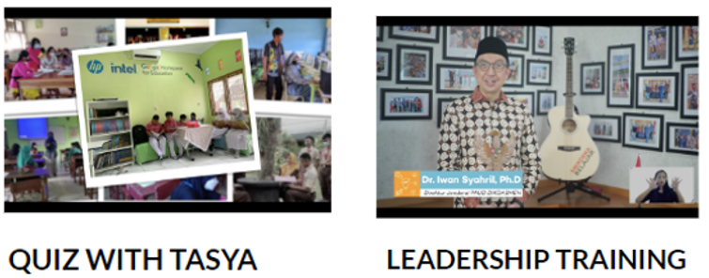

Teacher Upskilling Collaboration with Ministry of Education Semangat Guru Virtual Learning Series (2021-2023)
Empowering Indonesian educators
The HP Semangat Guru virtual learning program aims to upskill and empower teachers across Indonesia. Launched in 2021 with the Ministry of Education, Culture, Research, and Technology (MOECRT), the program helps teachers better integrate technology into lessons. It also seeks to develop soft skills like the 6Cs: Critical Thinking, Creativity, Collaboration, Communication, Computational Logic, and Compassion.
Teachers can access the program’s Learning Management System for over 50 modules on topics such as basic computer skills, online assessment, e-learning design, and digital content creation. A knowledge repository provides additional resources on demand.
Recognizing the value of peer-to-peer learning, we created various online communities where teachers can share ideas and sponsor offline, in-person events.
To date, Semangat Guru has reached 8.6 million teachers, education personnel, and students, strengthening the Indonesian education system and equipping students for success in the digital age.
Notes:
Mendorong siswa-siswa untuk mengadopsi keterampilan masa depan (6C):
Collaboration (Kolaborasi)
Communication (Komunikasi)
Creativity (Kreativitas)
Critical Thinking (Berpikir Kritis)
Compassion (
Computational Thinking (

