Slide 1

US-ABC Member Companies
Economic& Social Support
www.herbalife.co.id
Quick Facts
Herbalife Nutrition has been operating in Indonesia since 1998. It currently employs 221 people in Indonesia. Herbalife Nutrition is a leading global nutrition company that focuses on promoting balanced nutrition and healthy active lifestyle in more than 90 countries, including Indonesia.
Social and Community Support ─ Key Highlights/Summary
Through one of its key initiatives, Nutrition for Zero Hunger, Herbalife Nutrition aims to help end world hunger and ensure people’s access to good nutrition. Herbalife Nutrition Foundation has been working with local partners in Indonesia to implement 4 (four) Casa Herbalife Nutrition programs as follows:
Partnership with Habitat For Humanity Indonesia on Sanitation Program
This project aims to construct clean water access and sanitation facilities in Mauk, Tangerang. The project has benefited 11,900 direct individual beneficiaries and 15,350 indirect individual beneficiaries.
Herbalife Nutrition Indonesia is currently in discussion with the Indonesian Ministry of Health (MOH) to integrate this project with the MOH’s Stunting Prevention program.
Partnership with Pondok Kasih Agape to Provide Daily Nutritious Meals and Educational Programs to Orphaned Children
This project provides daily nutritious meals and educational programs to 150 children in Pondok Kasih Agape Orphanage in Jakarta.
Partnership with Rumah Autis to Provide Daily Nutritious Meals and Educational Programs to Children with Special Needs
The project provides daily healthy meals and educational programs to 250 children with special needs in Rumah Autis.
Partnership with Bali Caring Community on Daily Healthy Meals Provision Program
The project aims to support the government program in combating malnutrition by providing daily healthy breakfast to 100 underprivileged children in Karangasem, Bali.

Slide 2

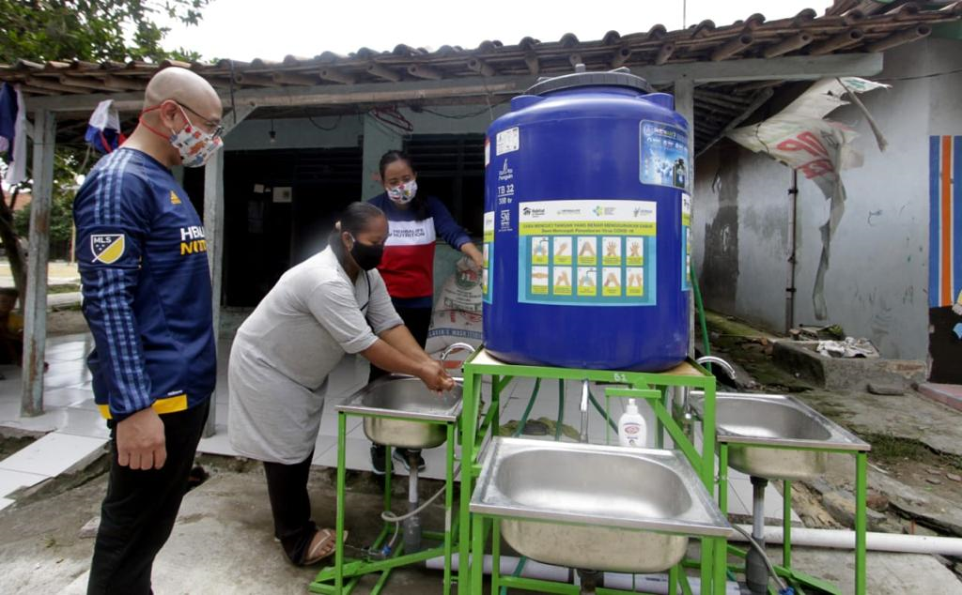
US-ABC Member Companies
Economic & Social Impact
www.herbalife.co.id
Social and Community Support ─ Current/Upcoming Programs
In 2019, Herbalife Nutrition launched Nutrition for Zero Hunger, a global initiative aimed at helping end world hunger, ensuring people’s access to good nutrition, and tackling the global challenges of food insecurity and malnutrition. The initiative is aligned with the UN Sustainable Development Goal No. 2, which calls for bold actions to end hunger by 2030.
For that reason, Herbalife Nutrition Foundation (HNF) collaborates with local partners in Indonesia to implement the following Casa Herbalife Nutrition programs:
Partnership with Habitat For Humanity Indonesia on Sanitation Program
This project aims to eradicate poor hygiene practices underlying stunting and malnutrition in Mauk, Tangerang, through the construction of clean water access and sanitation facilities for underprivileged families. The project has benefited 11,900 direct individual beneficiaries and 15,350 indirect individual beneficiaries.
HNF has provided USD 100,000 for Phase 1 of the project (2019-2020), another USD 100,000 for Phase 2 of the project (2021-2022), and will continue providing USD 100,000 for phase 3 (2023-2024).
Herbalife Nutrition Indonesia is currently in discussion with the Indonesian Ministry of Health (MOH) to integrate this project with 4 (four) pillars of the MOH’s Stunting Prevention program, namely:
Aksi Bergizi (Nutritious Action)
Herbalife plans to help cultivate the habits of doing exercises, having breakfast, and taking blood booster tablets to reduce anemia among female high school and/or junior high school students in Mauk, Tangerang.
Bumil Sehat (Healthy Pregnant Mothers)
Herbalife plans to launch campaign and provide education to improve health examinations of pregnant mothers in Mauk, Tangerang and enhance their knowledge of stunting risks and ways to prevent stunting.
Posyandu Aktif (Active Posyandu)
Herbalife plans to help enhance the scope of growth and development of infants in Posyandu in order to conduct early detection to prevent deficient nutrition and stunting in infants in Mauk, Tangerang.
Cegah Stunting Itu Penting (It’s Important to Prevent Stunting)
Herbalife also plans to help design and publish content to educate members of the public on the danger, risk factors, and ways to prevent stunting and malnutrition.

Slide 3
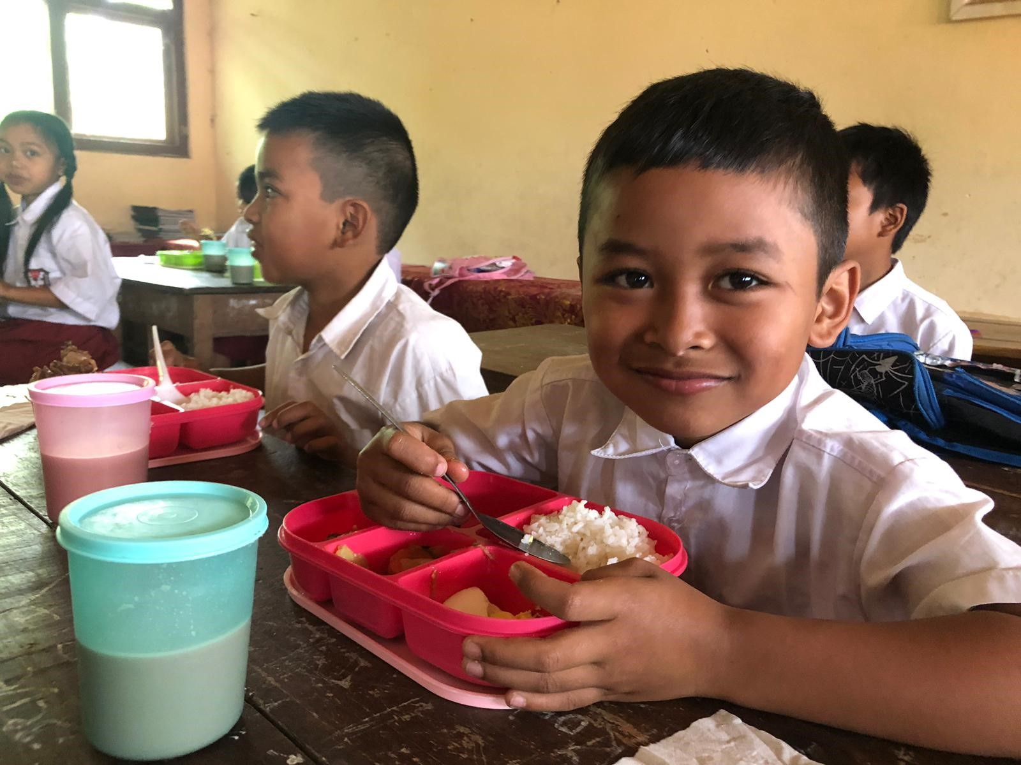
US-ABC Member Companies
Economic & Social Impact
www.herbalife.co.id
Social and Community Support ─ Current/Upcoming Programs
2) Partnership with Pondok Kasih Agape to Provide Daily Nutritious Meals and Educational Programs to Orphaned Children
HNF donated USD 22,000 in 2019-2020 to Pondok Kasih Agape in Jakarta, which joined the program in 2012. The project provides daily nutritious meals and educational programs to 150 orphaned children, including English course, sports, dance, and art programs. HNF subsequently donated USD 20,000 in 2021-2022, and another USD 20,000 in 2022-2023 for this program.
3) Partnership with Rumah Autis to Provide Daily Nutritious Meals and Educational Programs to Children with Special Needs
HNF donated USD 40,000 in 2019, USD 22,000 in 2020, USD 40,000 in 2021, and another USD 40,000 in 2022 to Rumah Autis, which joined the program in 2013. The partnership is aimed at providing 250 children with special needs with healthy nutrition, educational programs, and other programs such as art, music, and sports.
4) Partnership with Bali Caring Community on Daily Healthy Meals Provision Program
The project aims to support the government program in combating malnutrition by providing daily healthy breakfast and nutrition education to 100 underprivileged children in Karangasem, Bali. HNF donated USD 55,860 in 2019, USD 26,800 in 2020, USD 33,867 in 2021, and USD 31,333 in 2022.
* * * * * *

