Slide 1

Brno Declaration on Fostering a Global Ecosystem of Research Infrastructures
International Conference on Research Infrastructures (ICRI)
19–21 October 2022, Brno, Czech Republic

Slide 2
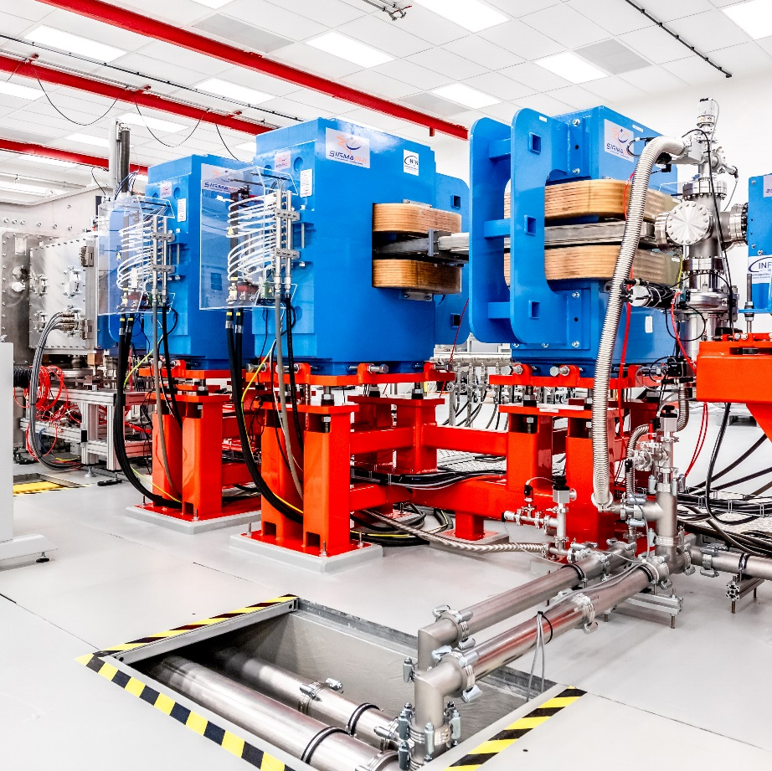
1. Introduction
Context
Research infrastructures (RIs) among top priorities of the Presidency of the Czech Republic of the Council of the EU in the 2nd half of 2022
Council Conclusions – Policy orientations encouraging consolidation, integration and further advancement of the European RI ecosystem
Brno Declaration – Complementary political document to the Council Conclusions, approaching the RI stakeholders from around the world
Objectives
Acknowledge the key attributes of RIs constructed and operated in all research disciplines and across all scientific and technological domains
Invite the RI policy-makers and funders, operators and users, and other stakeholders, including outside research and innovation (R&I), to foster a global RI ecosystem, including both large-scale installations, and mid- and small-sized RIs, as well as single-sited, distributed, and virtual RIs
Endorsement
Political support by the EU Member States and European Commission through an endorsement letter issued for the Presidency of the Czech Republic of the Council of the EU

Slide 3
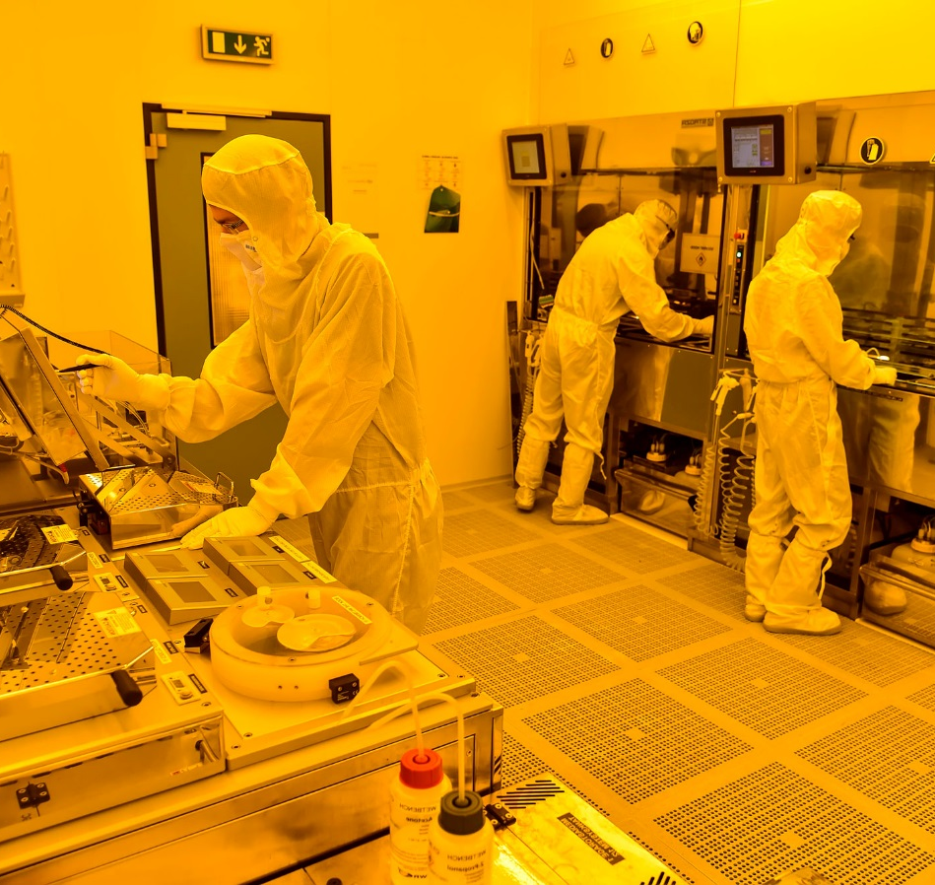
2. General Policy Perspectives (I)
Contributing to Excellence
RIs are top-class facilities, providing R&I community unique knowledge and expertise, experimental devices and technical resources, as well as extensive data set collections, and related ICT and computing services
Concentrating Resources
RIs bring together a critical mass of scarce resources (human, material, financial) and enable their user communities to achieve R&I results that would be very difficult to achieve by individual R&I actors
Pioneering Open Science Policy
RIs operated on the open access policy basis, serving users regardless their institutional affiliation and nationality, and sharing scientific data in interdisciplinary way and internationally pioneer open science policy
Advancing Regional Development
RIs trigger and accelerate societal and economic development of their sites and neighbouring regions by attracting talent and investments, stimulating supply chains, and amplifying the civil infrastructure and related services

Slide 4
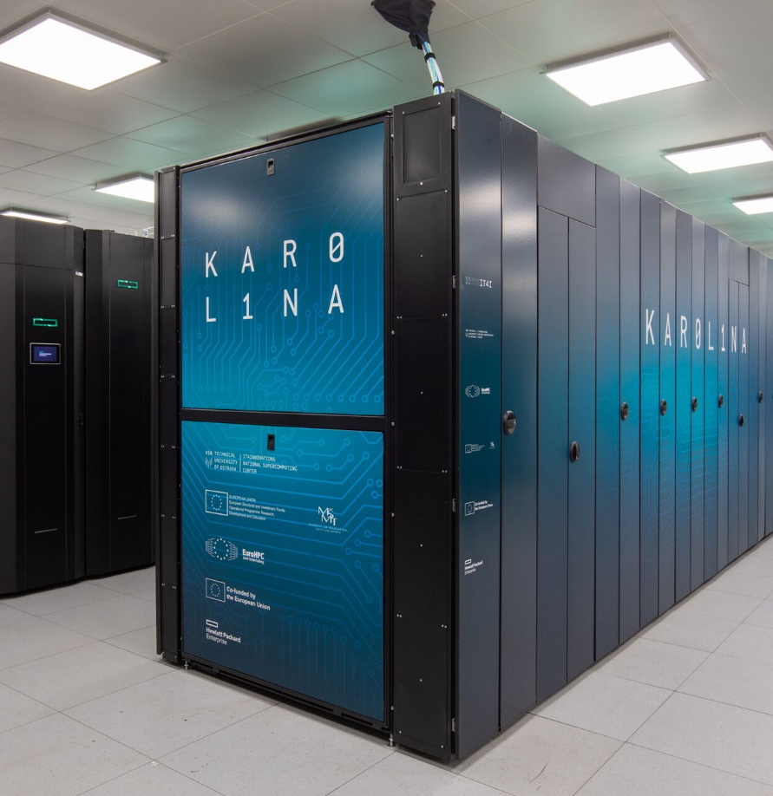
2. General Policy Perspectives (II)
Impacting Society and Economy
RIs facilitate problem-solving and solution-oriented approaches through multi-disciplinary and cross-sectorial collaboration in order to cope with pressing social, health, environmental, economic and other challenges
Bridging Research Gap and Closing Innovation Divide
RIs, by creating geographically well-balanced networks and corridors of knowledge hubs, hold a great potential to help bridge the research gap and close the innovation divide between macro-regions
Completing Critical Infrastructure
RIs empower scientists and equip innovators to come up with novel and feasible solutions to sudden threats, and increase the immediate response capacity of the society to deal with acute crisis scenarios
Facilitating Science Diplomacy
RIs play a key role as instruments of science diplomacy, keeping communication channels open and building understanding and trust between nations and cultures, including those with difficult political relationships

Slide 5
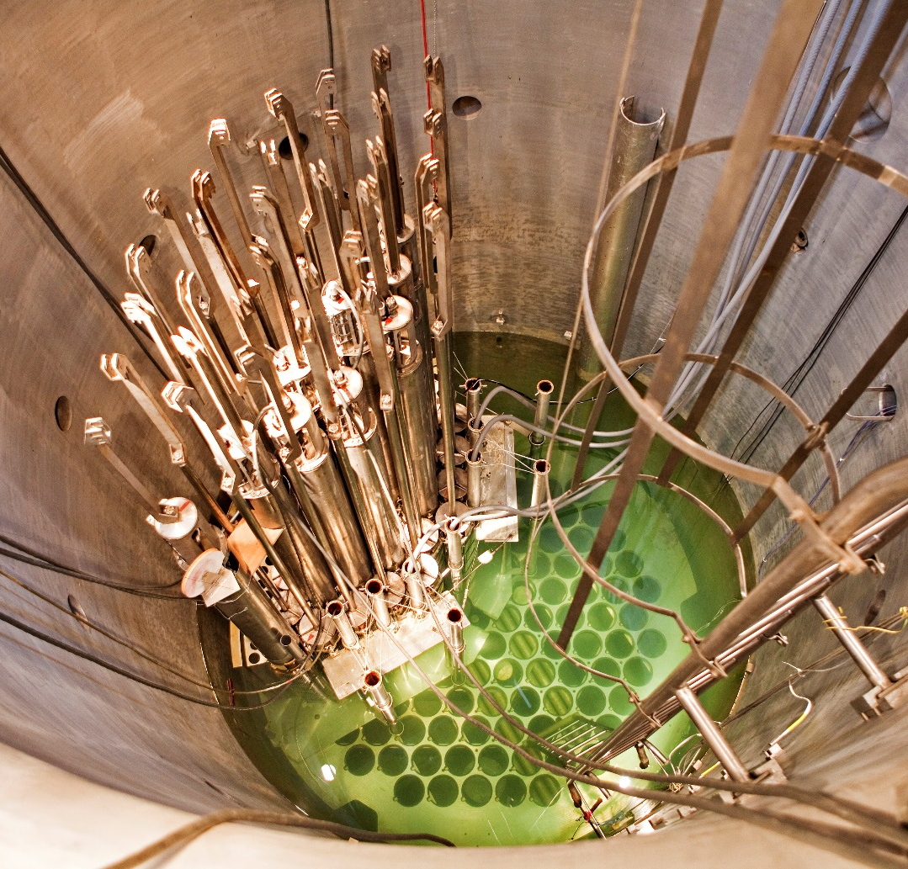
3. Call for Action (I)
Converging Sectorial Policies
Place RIs at the forefront of policy-making and explore convergence of policy-making on RIs with other sectorial policy approaches in areas, where RIs enable knowledge-based solutions to grand societal needs and help facilitate prosperity and well-being
Ensuring Long-Term Sustainable Development
Consider RIs a strategic investment and long-term commitment in order to create a stable, reliable and predictable funding environment enabling effective RI financial planning throughout all their life-cycle phases
Exploiting Potential of Synergic Funding
Harvest the full potential of synergies in the RI funding by combining in a complementary way financial resources allocated to implement research, educational, innovation, industrial, regional and other sectorial policies
Fostering Global Research Infrastructure Ecosystem
Incentivise networking, clustering and integrating of RIs, thus combining RI capacities and capabilities at the national, macro- regional and global levels, and contributing to the development of an integrated global RI ecosystem

Slide 6
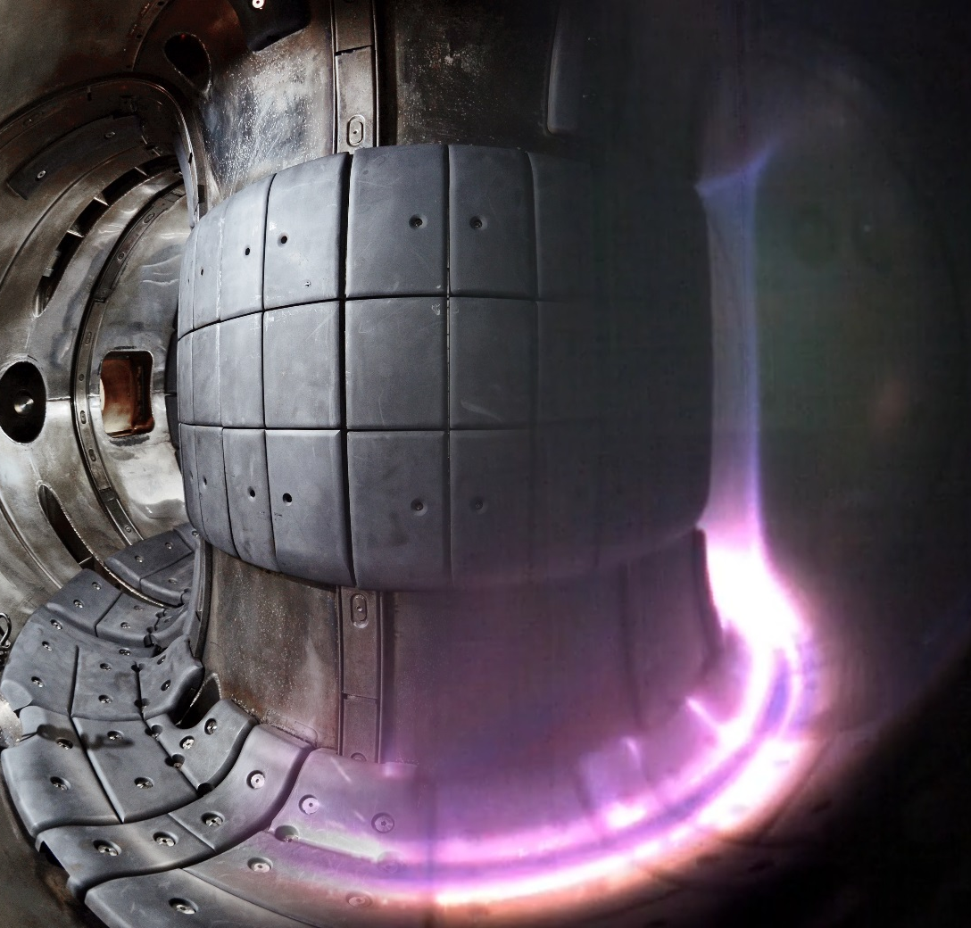
3. Call for Action (II)
Cooperating Internationally
Set up a dialogue on the principles for the international RI collaboration, such as the balanced reciprocal openness, promoting a level playing field underpinned by fundamental values and common framework conditions
Sharing Experiences and Exchanging Good Practices
Share experiences and exchange good practices internationally on the RI policy-making, funding, roadmapping, landscape analysis, user strategies, access policies, governance, management, monitoring and assessment
Leading Debates in International Fora
Seize the opportunity of holding International Conference on Research Infrastructures (ICRI) as a global RI forum to address on a regular basis topics of common interest and explore ways for actionable outcomes
Strengthening Science Diplomacy
Engage with policy-makers in the foreign and security policy domains on the role RIs can play as tools of science diplomacy in the complex geopolitical situation

Slide 7


Slide 8


Slide 9




Slide 10


Thank you very much for your attention!
Mr VÁCLAV VELČOVSKÝ Deputy Minister
for the European Union, International Affairs and the EU Cohesion Policy Funds
Office: +420 234 812 250
E-mail: Vaclav.Velcovsky@msmt.cz

