Slide 1


2019 WELL-BEING REPORT
SWITZERLAND
2019 WELL-BEING REPORT
Barrett Academy for the Advancement of Human Values

Slide 2

Overall Score and Ranking
Year | 2014 | 2016 | 2018
GCI Score | 658 | 649 | 651
World Ranking | 1 | 5 | 5
Worldview | People Awareness | People Awareness | People Awareness
Switzerland ranks # 5 in the world just after Denmark and ahead of Iceland.
The overall level of well-being has dropped in recent years.
People Awareness | 630-679 | Norway, New Zealand, Finland, Denmark, Switzerland, Iceland, Sweden, Ireland, Canada.
For more information see:
https://www.barrettacademy.com/atlas-of-consciousness

Slide 3

Worldviews
Worldview | GCI score | Number of nations
Humanity Awareness | Above 680 | 0
People Awareness | 630–679 | 9
Wealth Awareness | 580–629 | 7
Nation Awareness | 480–579 | 22
State Awareness 1 | 380–479 | 34
State Awareness 2 | 280–379 | 41
State Awareness 3 | Below 280 | 32
GCI 2018

Slide 4

PEOPLE AWARENESS
1. Norway
2. New Zealand
3. Finland
4. Denmark
5. Switzerland
6. Iceland
7. Sweden
8. Ireland
9. Canada

Slide 5
Focus of 17 Global Indicators
Focus of each level of consciousness |  | Types and (number) of indicators
7 | Satisfying citizens’ needs for stability, well-being and happiness. | Strength, stability and legitimacy of the State (16), and level of happiness of the people (17).
6 | Satisfying citizens’ needs for environmental quality and environmental preservation. | Health and quality of the natural environment (14), and quality of preservation efforts (15).
5 | Satisfying citizens’ needs for inclusion, fairness, openness, tolerance and transparency. | Strength of personal relationships, social network support and civic participation (social cohesion) (12), and foundations and opportunities for social progress (13).
4 | Satisfying citizens’ needs for freedom, equality and accountability. | Legal rights, individual freedoms and social tolerance, (8) level of democracy (9), press freedom, (10) and gender equality (11).
3 | Satisfying citizens’ needs for education, and a supportive, business environment. | Access to and quality of education (6), business infrastructure support to entrepreneurs and labour market flexibility (7).
2 | Satisfying citizens’ needs for safety, protection and peace. | Societal safety and security (4), and the level of militarization and peace/violence (5)
1 | Satisfying citizens’ needs for health care and economic performance. | Level of corruption (1), physical and mental health infrastructure (2) and economic performance (3).

Slide 6
Focus of 17 Global Indicators
GCI Score
Level 1
Level 2
Level 3
Level 4
Level 5
Level 6
Level 7
1
2
3
4
5
6
7
8
9
10
11
12
13
14
15
16
17
Deficiency Needs
Transformation
Growth Needs
(1) Corruption (2) Health infrastructure (3) Economic performance (4) Personal safety (5) Level of peace/violence (6) Education (7) Business support
(8) Individual freedom
(9) Level of democracy
(10) Press freedom
(11) Gender Equality
(12) Social cohesion
(13) Social progress (14) Environment quality (15) Environment protection
(16) Strength, stability and legitimacy of State
(17) Happiness
For more information see: https://www.barrettacademy.com/global-consciousness-indicator

Slide 7
Level of Consciousness Scores
 | Level 1 | Level 2 | Level 3 | Level 4 | Level 5 | Level 6 | Level 7 | Overall
2014 | 96.05 | 97.69 | 94.32 | 87.39 | 93.54 | 91.64 | 97.05 | 657.68
2016 | 96.52 | 94.34 | 95.41 | 87.09 | 88.63 | 88.27 | 98.54 | 648.80
2018 | 96.13 | 91.64 | 93.96 | 85.08 | 93.96 | 93.11 | 97.53 | 651.42
Change 2014 - 2018 | 0.08 | -6.05 | -0.36 | -2.31 | 0.42 | 1.47 | 0.49 | -6.26
Rank 2018 | 2 | 11 | 5 | 14 | 10 | 1 | 4 | 5
Consistent
Best performances
Consistent improver
Worst performances
Consistent decliner
For more information see: https://www.barrettacademy.com/gci-tables-2018

Slide 8
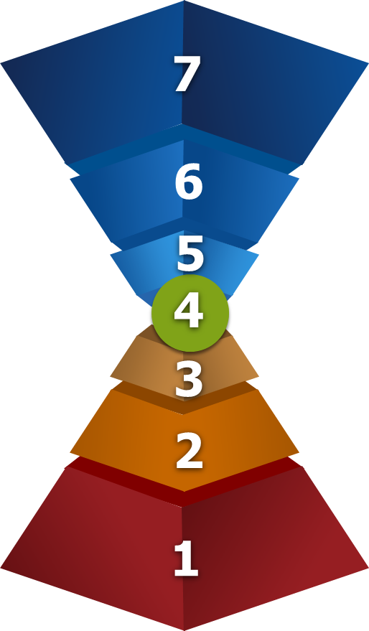

Notes on Level of Consciousness Scores
Level 7 has the highest level of performance.
Level 4 has the lowest level of performance.
Levels 6 and 1 have the highest rankings in 2018.
Levels 4 has the lowest ranking in 2018.
Levels 2 and 4 are consistent decliners.
There are no consistent improvers.

Slide 9
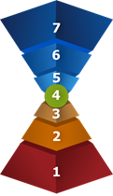

Deficiency Needs
LEVEL 1
LEVEL 2
LEVEL 3
2014
2016
2018
Change 2014 - 2018
Rank 2018
Consistent
(1) | (2) | (3)
92.59 | 100.00 | 95.56
94.74 | 99.13 | 95.70
95.95 | 96.73 | 95.71
3.35 | -3.27 | 0.15
3 | 4 | 4
(4) | (5)
98.48 | 96.90
96.17 | 92.51
95.77 | 87.51
-2.71 | -9.40
13 | 12
(6) | (7)
100.00 | 88.65
100.00 | 90.82
99.77 | 88.16
-0.23 | -0.49
2 | 10
Best performances
Consistent improver
Worst performances
Consistent decliner

Slide 10
Transformation Needs
LEVEL 4
2014
2016
2018
Change 2014- 2018
Rank 2018
Consistent
(8) | (9) | (10) | (11)
86.85 | 90.05 | 95.74 | 76.92
88.29 | 90.04 | 95.74 | 74.29
83.39 | 89.94 | 95.70 | 71.31
-3.46 | -0.11 | -0.05 | -5.61
21 | 10 | 12 | 19
Best performances
Consistent improver
Worst performances
Consistent decliner

Slide 11
Growth Needs
LEVEL 5
LEVEL 6
LEVEL 7
2014
2016
2018
Change 2014 -2018
Rank 2018
Consistent
(12) | (13)
87.39 | 99.68
78.36 | 98.90
88.37 | 99.55
0.98 | -0.13
13 | 3
(14) | (15)
83.28 | 100.00
83.53 | 93.00
86.23 | 100.00
2.94 | 0.00
10 | 1
(16) | (17)
94.99 | 99.10
97.44 | 99.63
98.14 | 96.93
3.14 | -2.16
3 | 5
Best performances
Consistent improver
Worst performances
Consistent decliner

Slide 12
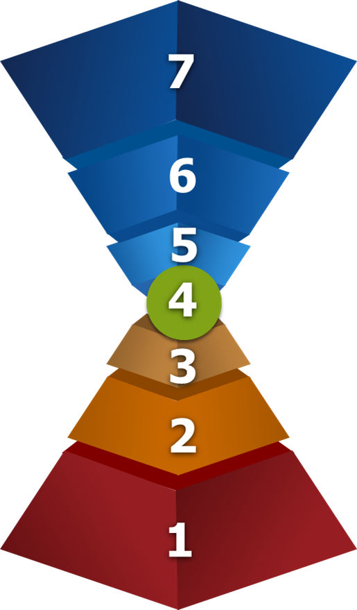
Positive Indicators
The best performers are Health Infrastructure (2), Social Cohesion (12), Education (6), Environment Protection (15), Personal Safety and Level of Happiness (17).
The best improvers are reduced Corruption (1), Strength, Stability and Legitimacy of the State (16), Environment Quality (14) and Economic Performance (3).
The best rankings are Environment Protection (15), Education (6), reduced Corruption (1), Social Progress (13) and Strength, Stability and Legitimacy of the State (16).

Slide 13

Negative Indicators
The worst performers are Gender Equality (11), Environment Quality (14), Individual Freedom (8), Business Support (7) and Social Cohesion (12).
The worst decliners are Level of Peace (5), Gender Equality (11) and Individual Freedom (8).
The worst rankings are Indiviudal Freedom (8) and Gender Equality (11).

Slide 14
Key Findings
The biggest strengths of Switzerland are its commitment to Education (6), Environment Protection (15), Level of Happiness (17), Health Infrastructure (2), Social Progress (13) and Personal Safety (4).
Consistent progress has been made in reducing Corruption (1), Strength, Stability and Legitimacy of the State (16), Environment Quality (14) and Economic Performance (3).
The biggest causes for concern are Gender Equality (11), Environment Quality (14), Individual Freedom (8) and Business Support (7).
Consistent decreases have occurred in Level of Peace (5), Gender Equality (11), Level of Democracy (9),Personal Safety (4) and Health Infrastructure (2).

Slide 15
Summary
The overall level of well-being in Switzerland has dropped in recent years.
Switzerland has a strong commitment to Health Infrastructure, Personal Safety, Education, Social Progress, Environment Protection and the Happiness of citizens.
The most important issue in Switzerland is the increase in violence.
Other causes for concern include the low, and declining level Gender Equality and Individual Freedom.

